Slide 1
Computer Vision Final Project- Captcha Recognition
Group : 11
109502561 顏紹同

Slide 2
1. Motivation
CAPTCHA (Completely Automated Public Turing test to tell Computers and Humans Apart) is used by websites to differentiate between real users and bots.
These challenges are omnipresent on the dark web to protect platforms from the constant DDoS attacks that competing platforms launch against each other.

Slide 3
2. Goal
Recognize input captcha image and output its’ correct code
Can further use on dark web crawler

Slide 4

3. Dataset
Dataset from Kaggle

Slide 5
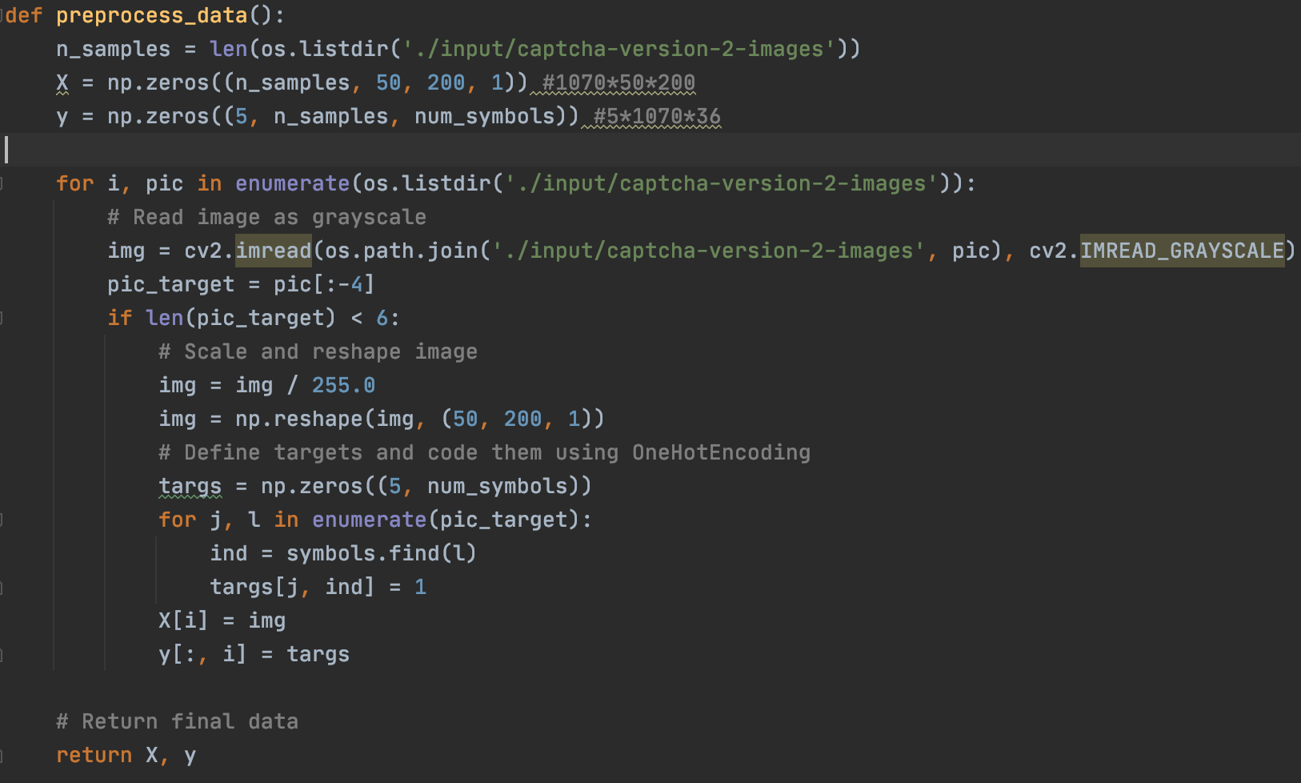
3. Dataset
Data preprocessing

Slide 6
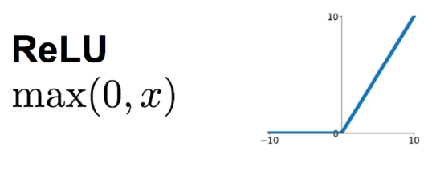
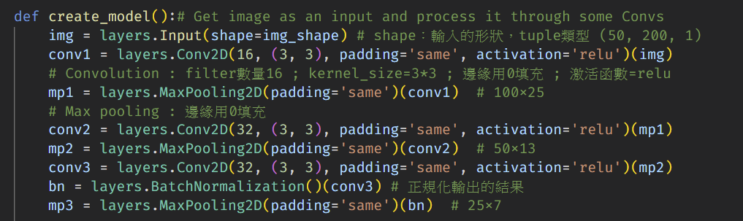
4. Model
Use ReLU as activation function:
calculation fast
accelerate the convergence speed
the problem of gradient disappearance is solved in the X>0 interval.

Slide 7
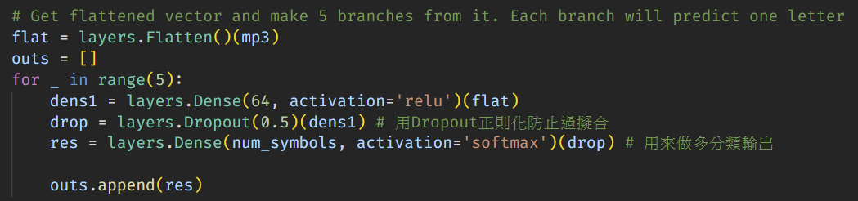
4. Model
Use tf.keras.layers.Dropout, which helps prevent overfitting
Use softmax as output layer activation function for multi-output classification

Slide 8
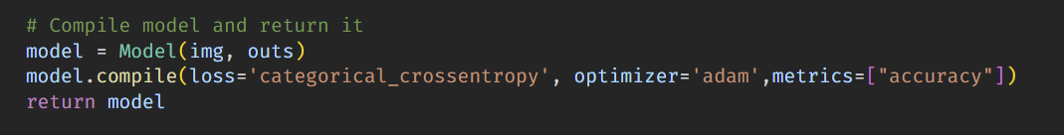
4. Model
Because we use softmax as output layer, so use categorical_crossentropy as loss function

Slide 9
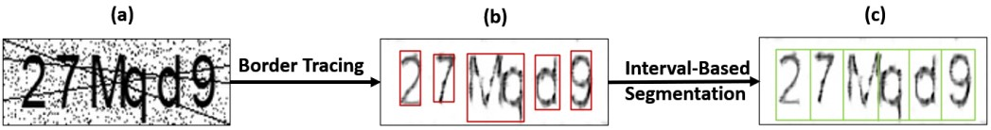
4. Model
Result should be like this:

Slide 10
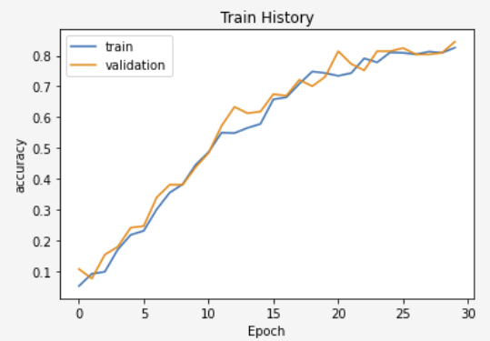
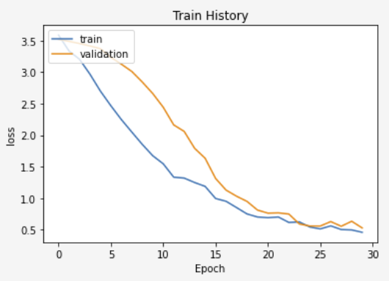
5. Result
Result when use sigmoid as output layer:

Slide 11
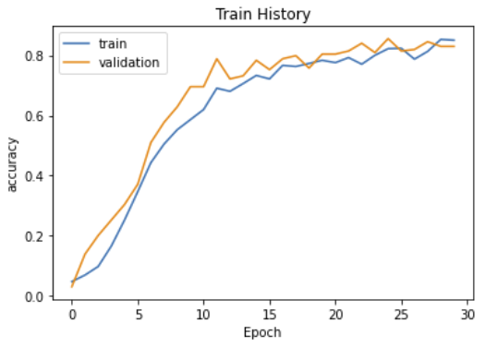
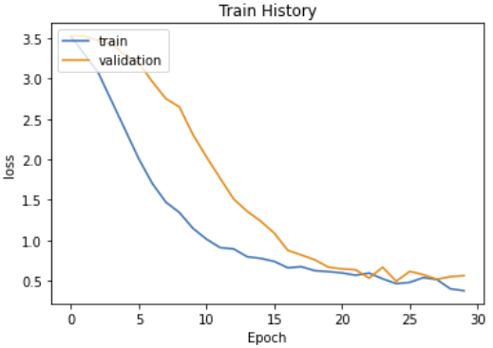
5. Result
Result when use softmax as output layer:

Slide 12
6. Demo Time!

